Slide 1
Our RPA journey and lessons learned
Gintautas Jonutis, Director
Automation & Analytics

Slide 2
WU RPA milestones
2016
2017
2018
Pilot:
1 Complex Process
6 Virtual Robots
12 FTEs Free Up for Innovation
21 automated Processes
40 Virtual Robots
48 FTEs Free Up for Innovation
44 automated Processes
~70 Virtual Robots
88 FTEs Free Up for Innovation

Slide 3
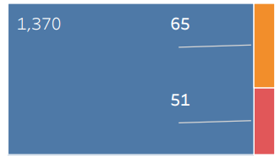
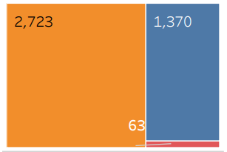
Automated Processes Dashboard
More than
1 million
Work Items successfully processed in 2018

Slide 4
Process selection
Everything begins from the openness to intake ideas for automations very widely within the organization
Ideas intake
IDEATION
HIGH LEVEL ANALYSIS
APPLY CRITERIA
Discovery / Recommend / Initial Analysis / Align
Accept / Reject

Slide 5
Development Agile circle
Agile approach being implemented to develop and deploy Robots releases faster with more visibility (Scrum)
DEFINE / DESIGN
CONFIG/ DEVELOP
UAT
CLOSE OUT
BENEFIT REALIZATION
Process Definition / Solution Design / Build / Test
User Acceptance Test / Deploy / Pilot/ Cutover
Evaluate / Measurement

Slide 6
Key findings after 3 years

Slide 7
#1 Measure real value. Every process have it different
Example: Customer Refunds process
Process is dealing with negative consequences of customer operations
RPA CoE is not impacting the workload
Number of robots can drastically vary (added, decommissioned) thought the months
Robots balancing unpredictable workload

Slide 8
#2 Think about Maintenance and Change Management in Design
New Development
Change Management
In 2018 ~28% of our developers capacity used for change management of existing robots/processes
Close cooperation with Business Units and Application owners is essential
Example:
Customer Care Proof of Payment Request process – Web application
HTML element ID change in web application impacted robot, but not employees

Slide 9
#3 Common RPA benefits are not so common
Robots work 24x7 *
Robots are from 2 to 5 x faster*
Robot can log all the process elements*
*Special conditions apply

Slide 10
#4 If possible – avoid processes where robot is in between Employee tasks
Example: Compliance alerts check process
Employees should work with the same work item twice. It’s typical waste.

Slide 11
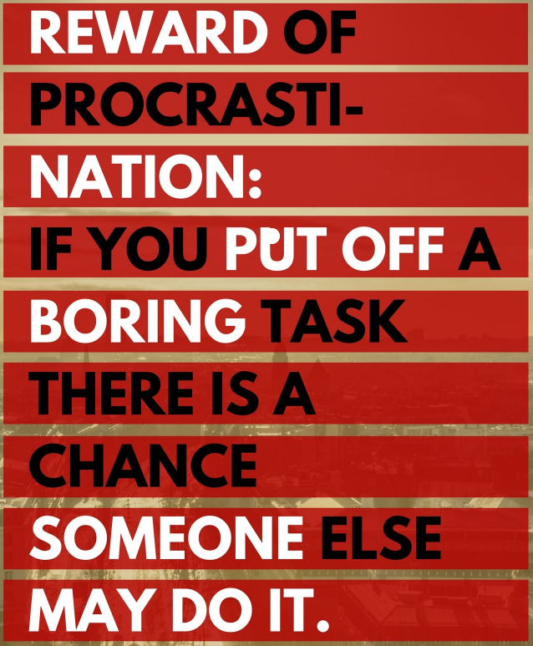
#5 Robot fits where human don’t
Examples:
In the processes, accessing of very sensitive data/application.
Process steps which is easy to miss or forget - CRM fills, info email sending etc.
Verifying different languages information. Example Japanese characters ID documents

Slide 12
#5 Don’t compete with FTEs, partner with them
Unattended RPA automation is very limited in end-to-end processes
We haven’t yet automated any process, where employees were fired
Our Operational Center use Automation even for Employee branding
Transforming our metrics from FTE savings to Cost Per Work Item reduction.
Automation is a tool for maximization of Employee work efficiency

Slide 13
RPA version 1.0
Extended RPA functionality with new tools
Bringing more responsibilities for Business units in Automation maintenance and development process
Agile/Scrum robots development
End-to-End Process Re-engineering
Desktop automation orchestration by CoE
On-board Customer facing automation tools, as chatbot, email bot
Basic RPA functionality
Automation initiative, development and maintenance driven by CoE
Waterfallish robots development. Everything or nothing.
Automating process episodes not full processes
Accidental desktop automation initiatives
No customer facing automation
RPA version 2.0

Slide 14
Thank You
Contact Information
Tel: +370 635 11882 Email: Gintautas.Jonutis@WU.com

