Slide 1
Felicia project - to automate manual work of Payment Team
2020-01-29 | Warszawa | Tatiana LipiNSKA-ZALUSKA & MIKOLAJ WITKOWSKI
January 2020

Slide 2
Payment Process
II stage
checking the correctness of this proposal.
I stage
the „Proposal”

Slide 3
Scope of payments in Kemira EMEA
Entities
Austria
Currency
Suppliers
Over 10.000
Belgium
Denmark
Estonia
Finland
France
Germany
Hungary
Italy
Norway
Poland
Portugal
Slovenia
Spain
Sweden
Switzerland
The Netherlands
The UK
EUR
USD
SEK
NOK
DKK
PLN
GBP

Slide 4
Why it was a good project for robotization?
Long, repetitive and daily process;
Global scope;
Process is binary;
No changes.

Slide 5
Why is it well executed project?
Excellent documentation;
Constant supervision;
Cooperation of process expert and developer;
Built in a very universal way.

Slide 6
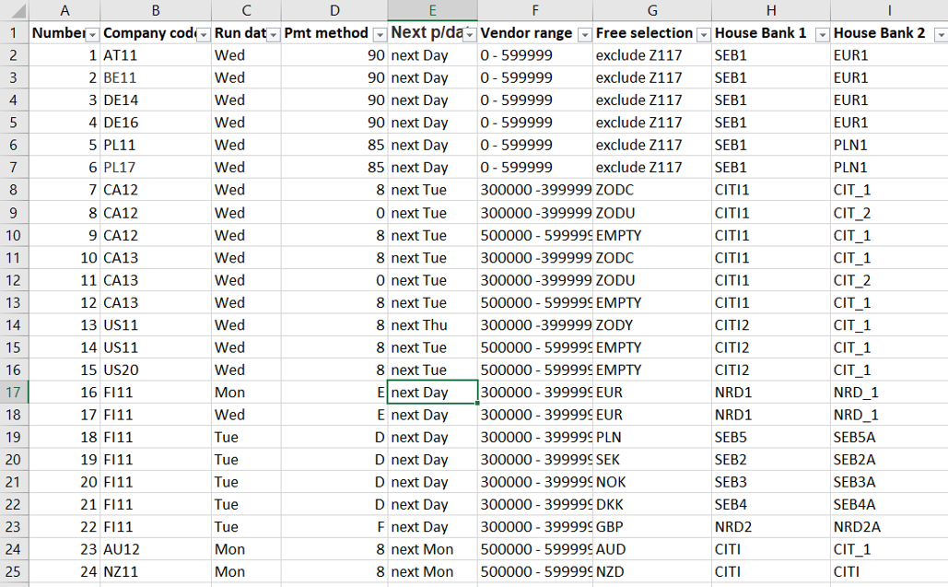

Slide 7
Conclusions
We shouldn’t be afraid of automation;
We need to be open and flexible to changes.

Slide 8
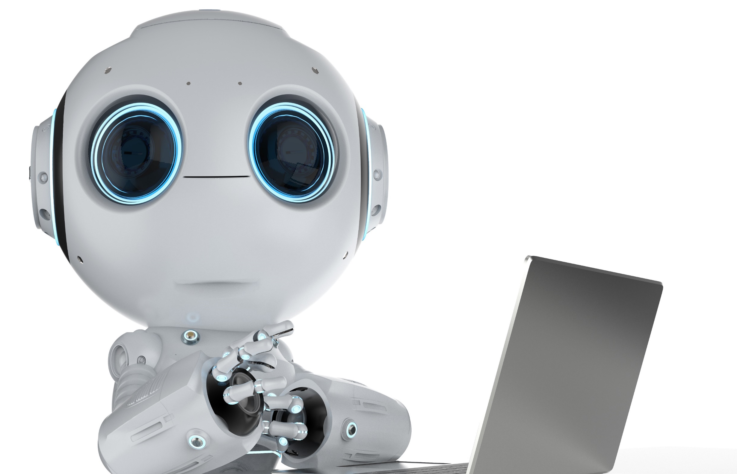
MEET FELICIA She is my favourite colleague today ☺

Slide 9
tatiana.lipinska-zaluska@kemira.com
mikolaj.witkowski@kemira.com

