Slide 1
‚Beaming Kraków’ in Euroclear
CEE Awards 2024

Slide 2
WE ARE EUROCLEAR IN POLAND
About us

Slide 3
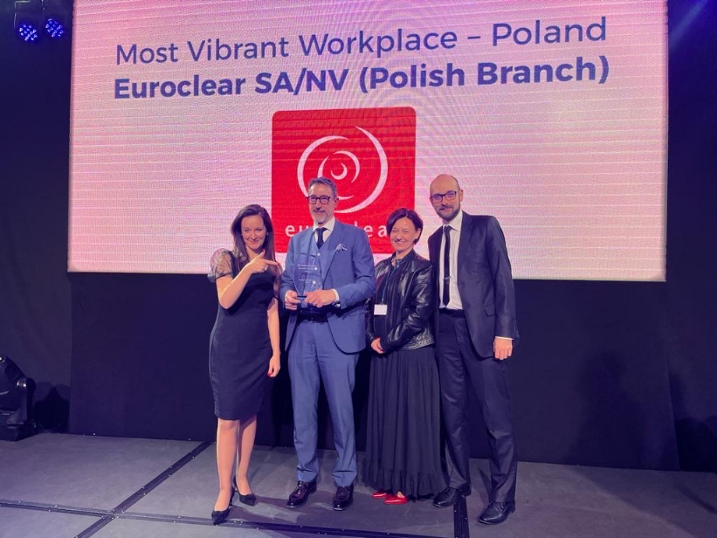
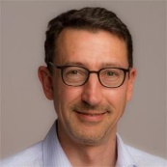
Euroclear Bank at CEE Awards
CEE Awards
2023: Most Vibrant Workplace
2024: Shortlisted in the following categories
Best University-Business Cooperation of the Year – Poland
Top Diversity & Inclusion Initiative – Poland
Business Centre Director – BSC – Poland:
Stephane Bernard

Slide 4
Best University-Business Cooperation of the Year – Poland
Best University-Business Cooperation - Poland

Slide 5
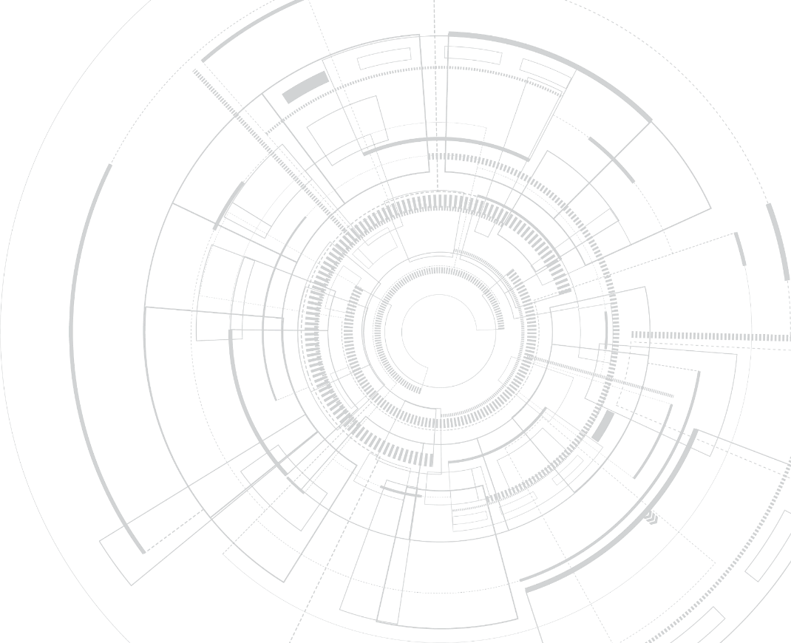
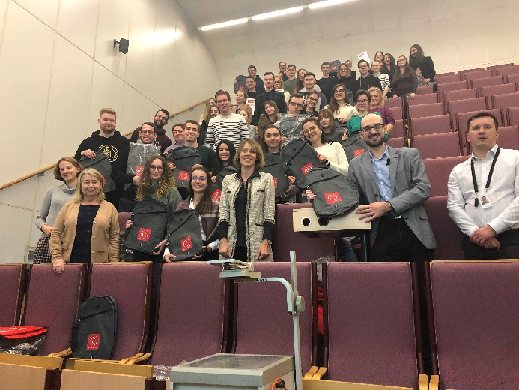
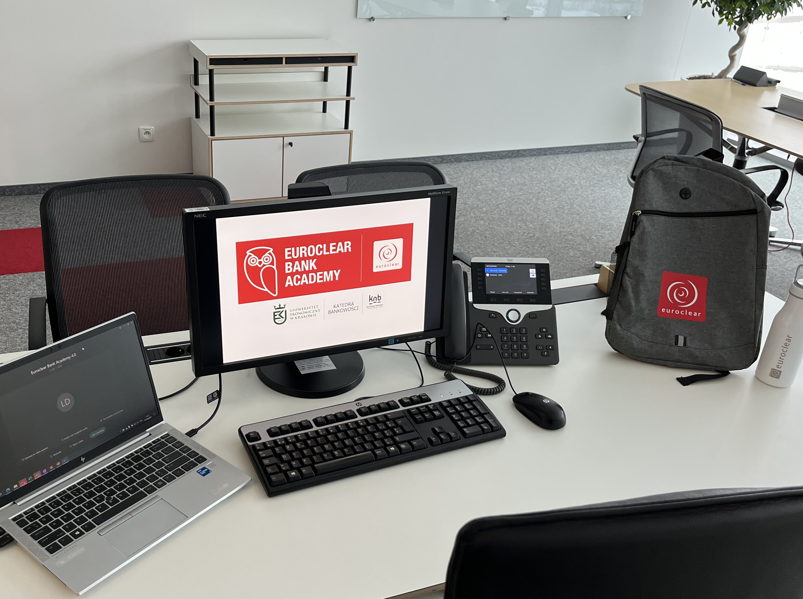
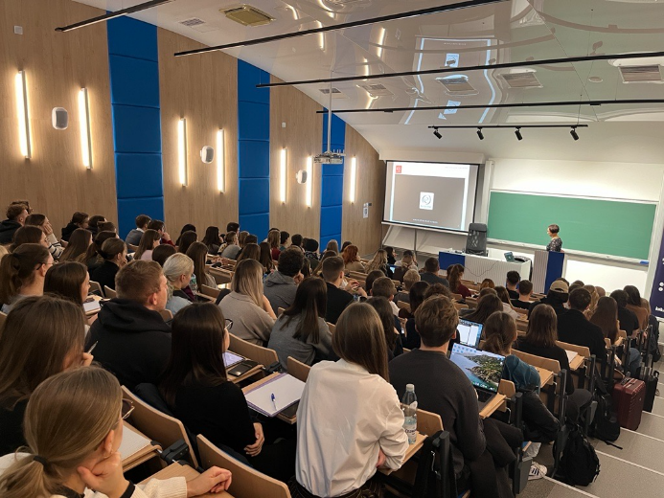
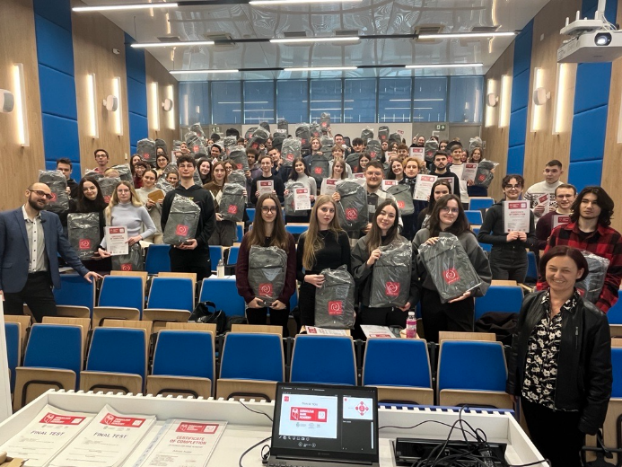
Best University-Business Cooperation - Poland
Core program
+500 participants
Series of six lectures about Financial Market
Part of the regular curriculum of International Finance
Open to all students of University of Economics in Krakow (UEK)
Awards for students (Certificate, Internship)
+400 graduates
+100
hires
5
1st 2019
UEK
2nd 2020
Online
3rd 2021
Online
4th 2022
Online
5th 2023
UEK

Slide 6
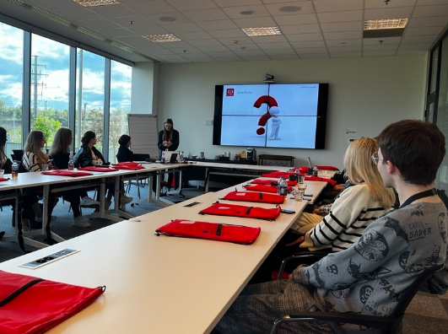
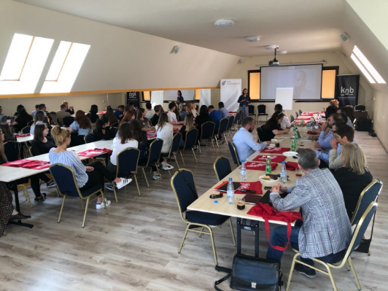
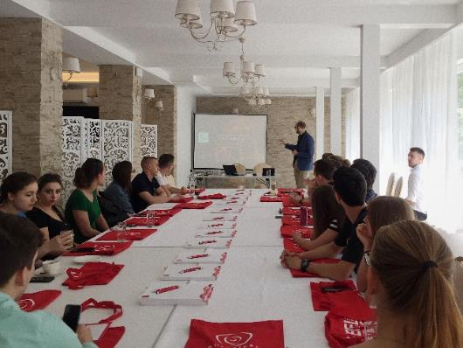
Best University-Business Cooperation - Poland
Banking ‚after hours’
Extension of the core program
Ad-hoc lectures on specific topics
Outside of the University (@Euroclear/@Student seminars/...)
Smaller interactive groups

Slide 7
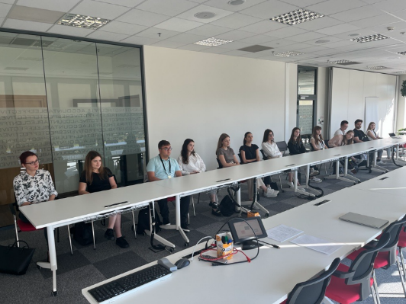
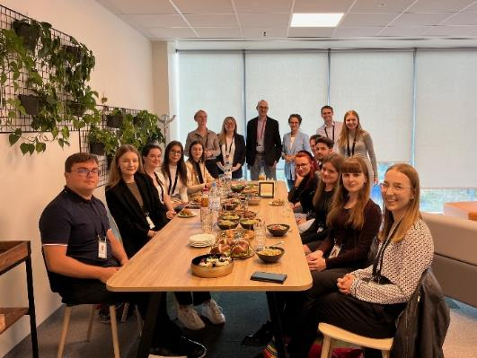
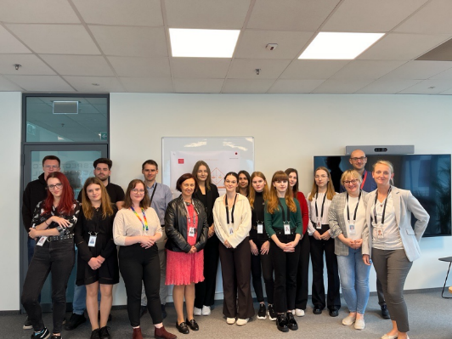
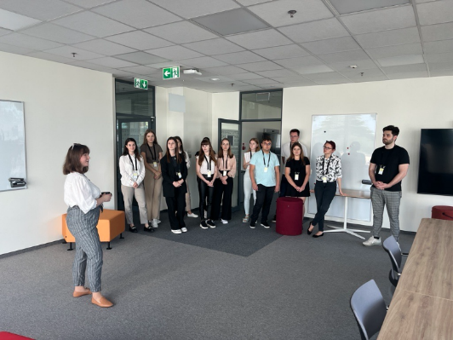
Best University-Business Cooperation - Poland
EBship – Internship program
Summer student internship
4-week long tailor-made program
Focused on students of Banking Faculty of UEK
Sign-ups for 2024 are open

Slide 8
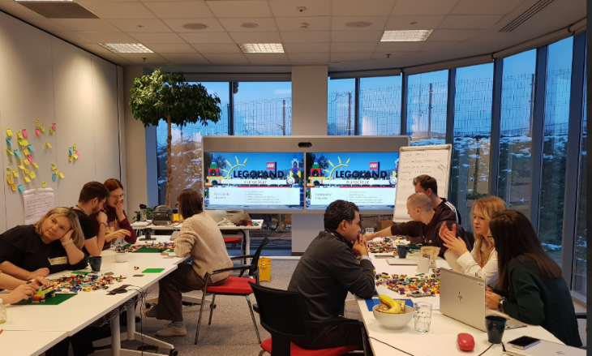
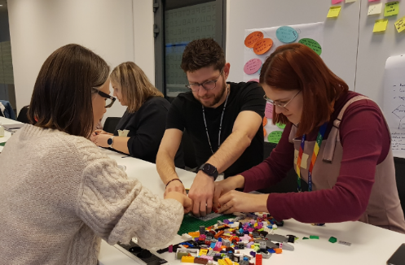
Top Diversity & Inclusion Initiative – Poland
Age
Proud
Network
Gender
Mental
Health
Disabilities

Slide 9
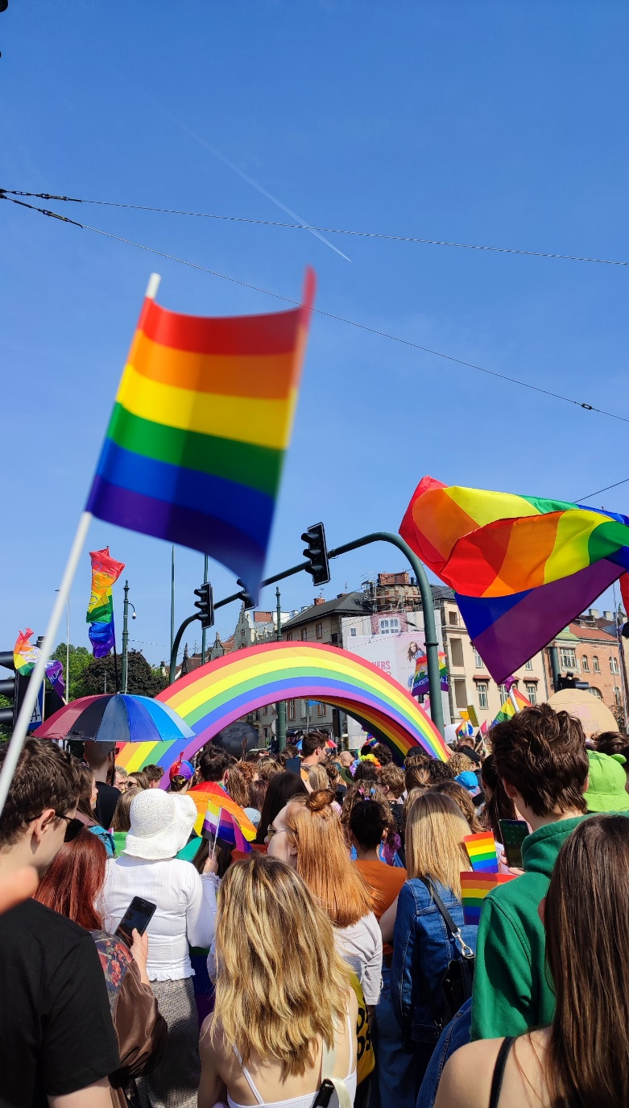
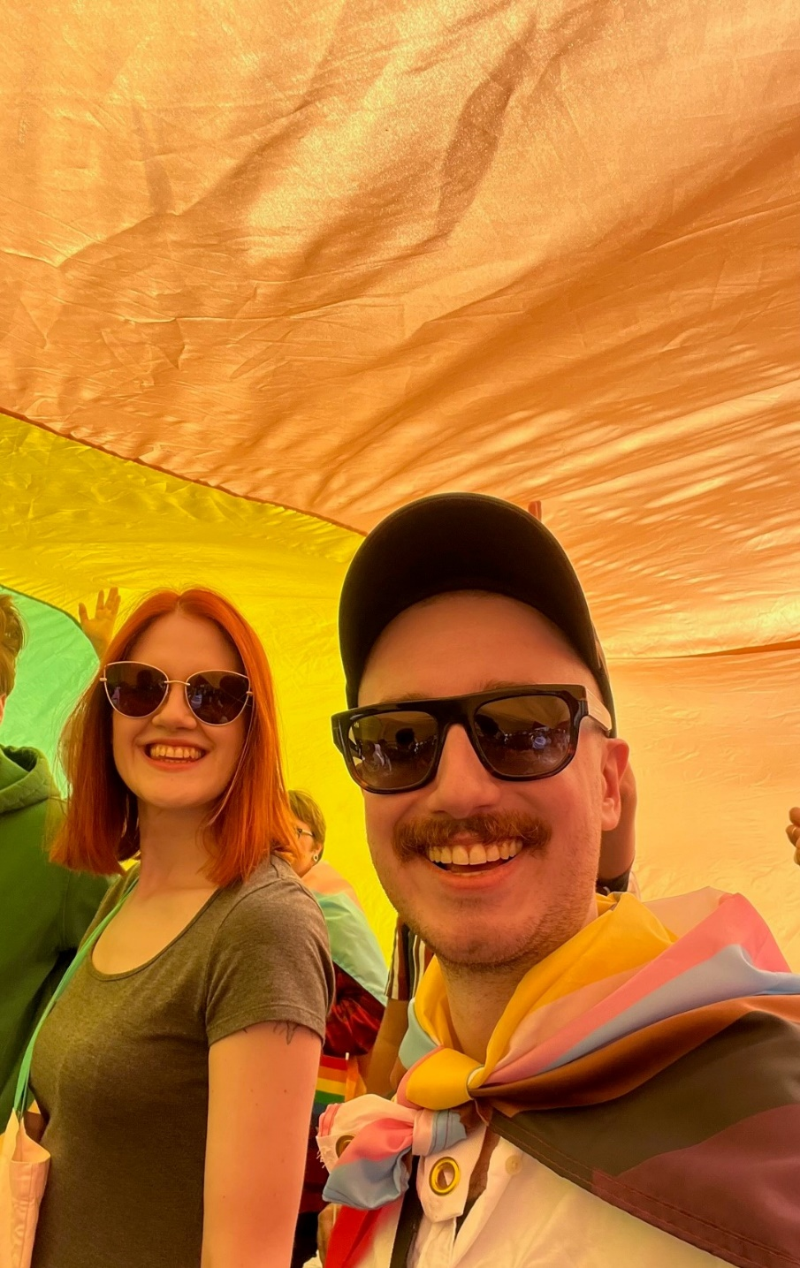
Top Diversity & Inclusion Initiative – Poland
Mental
Health

Slide 10
All with support and engagement of
Business Centre Director – BSC - Poland
Local empowerment to drive strategic objectives locally
Most Vibrant Workplace
Relationship with Universities
D&I sponsor
CSR initiatives
STEPHANE BERNARD
Branch Manager
Euroclear Bank Kraków
Operating model
Coined the term ‚Beaming Kraków’ to reflect the atmosphere of our dynamic, professional and innovative Kraków office

