Slide 1
How to hire robots for your office?
Mariusz Pultyn, CTO, Digital Teammates
Konrad Jakubiec, COO/CFO Digital Teammates
CEE Business Services Summit and Awards, 31.01.2019

Slide 2
Who we are ?
Mariusz Pultyn, CTO
Konrad Jakubiec, COO/CFO
Our mission
We automate boredom at work
Our vision
Work at which people can more and have to less
WORKING TECHNOLOGY

Slide 3
Context: what is RPA (Robotic Process Automation)?
Configurations that automate manual repetetive tasks
Virtual robots that integrate with existing software
Replication of desktop activities
Driven by rules and logic
Increase in quality and cost efficiency of back-office operations
WORKING TECHNOLOGY

Slide 4
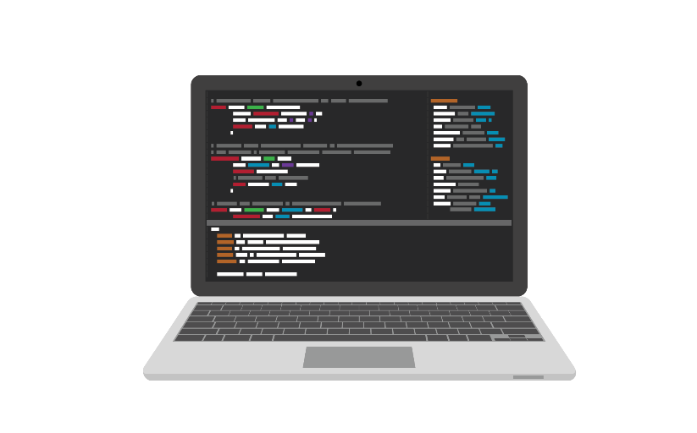
Case study – the future of the modern workplace
60 FTEs
Accurate
Scalable
Efficient
Inexpensive
+
Robots
100 FTEs
Payments
Data input
4 Teams
3 Teams
Monitoring
2. Data validation
Customer requests
3. Documents creation based on templates
WORKING TECHNOLOGY

Slide 5
Case study – mBank processes examples
Client | mBank
Process name | Standing orders handling
Process description | Based on client’s order, funds on the accounts have to be transfer few times a day to other accounts based on various rules. We deliver around 6000 transactions per month.
Main challenges | Volumes in this process increased 4 Times within half a year.
Robotic Solution | Robots read data from Excel file and rewrite them to corporate banking application to make a transfer.
Applications used | Excel, Globus (corporate banking application)
Client | mBank
Process name | Insurance policy handling
Process description | Verifying documents received from clients (scans) with their credit agreements and entering data from insurance policies into the application. After verification is done, system automatically rewrites data into other application.
Main challenges | The data comparison is very error prone for employees and about 50% of received data entry is incorrect.
Robotic Solution | Reads all data from one application and compare it with the other. If there’s anything out of order – robot completes the gaps
Applications used | mService (retail banking credit application), AFT (retail banking application)
Client | mBank
Process name | Credit certificates generation
Process description | Based on client’s request, an employee generates an opinion about indicated credit. In order to do that he has to locate needed data in one of the applications and generate the document.
Main challenges | Process requires using few applications and handling a lot of data – it is error prone for humans.
Robotic Solution | Robots are logging into applications and copying required data, then they paste it to the Word template to generate the certificate which is then filed to retail banking app.
Applications used | Word, mService (retail banking credit application), AFT, UniFlow (retail banking applications)
WORKING TECHNOLOGY

Slide 6
Case study – How did we introduce robots to the team ?
Do we need robots?
Which business model?
How to engage employees?
Where to start?
What’s next?
WORKING TECHNOLOGY

Slide 7
Case study – IPF Digital Processes Examples
Client | IPF Digital
Process name | Payouts sending
Process description | Robot processes all the required steps in SalesForce in order to send loan payouts to customers that have completed their application.
Main challenges | Creation of a robot that would mimic almost real time operations by logging in frequently and checking for new payouts to process.
Robotic Solution | Robot logs to SalesForce, finds dedicated report, marks all items and starts send operation. After that it checks the status and reports the result.
Applications used | SalesForce
Client | IPF Digital
Process name | Loan data calculation
Process description | Calculation of loan repayment schedule, based on parimeters gathered in CRM application.
Main challenges | Complex logic behind model calculating the repayment schedule.
Robotic Solution | Robot logs to SalesForce, finds dedicated report with applications ready for loan data calculation. It gathers the data form SF and starts excel macro that counts the data. Then it inputs the data for the application.
Applications used | SalesForce, Excel Macro
WORKING TECHNOLOGY

Slide 8
Thank you.
We’d love to answer your questions
Mariusz.Pultyn@dtmates.com
Tel. +48 606 779 318
Konrad.Jakubiec@dtmates.com
Tel. 510 292 991
WORKING TECHNOLOGY

