Slide 1
Future of Finance
2019 CEE Outsourcing Awards
Piotr Glowacki,
Senior Manager, Business Development CEE
Association of International Certified Professional Accountants – Management Accounting

Slide 2




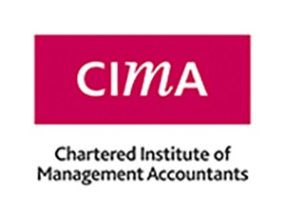
Stronger together for a stronger profession
The power of ONE
Two organizations have combined to bring the best of both worlds to corporate finance teams across the globe.
OPENS DOORS IN THE USA
REPRESENTING OVER 670,000 CURRENT AND NEXT GENERATION PROFESSIONALS
ENHANCED
EMPLOYABILTY
PROMOTING COMPETENCES GLOBALLY (PCG)
Notes:
ponad 100 000 CGMAs w USA

Slide 3

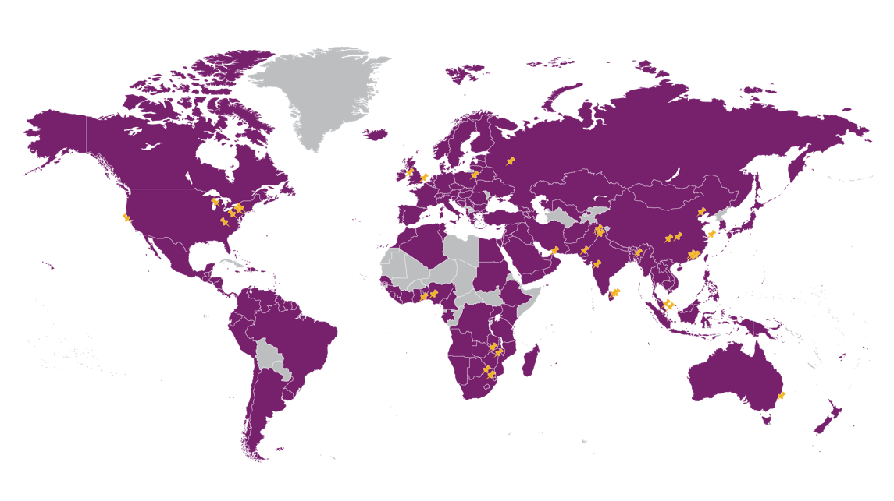
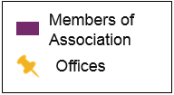
Association of International Certified Professional Accountants (The Association)
CIMA (Chartered Institute of Management Accountants joined forces with American Institute of CPA’s) creating world’s biggest accountancy body:
675,000
Members and students
183
Countries in our member
and student network
150,000
Firms and businesses employ
our members
4
Premier designations
supported: CPA and CGMA, ACMA, FCMA
17
Specialized credentials and
certificates offered
35
Office locations

Slide 4






















CIMA In Poland
Pathways cooperation with 7 top universities
SGH Warszawa
Koźminski University
Cracow University of Economics
Katowice University of Economics
Wrocław University of Economics
Poznan University of Economics
University of Łódź
~3 800 students & 800 members
Launched Poland office in Warsaw: Oct 2011
CIMA approved employers in Poland:
...and many more
Notes:
Skontaktuj się z nami: Poland@cimaglobal.com lub www.fb.com/CIMApoland
+48 22 222 19 90
Skylight Building, ul. Złota 59, 11 piętro, 00-120 Warszawa

Slide 5
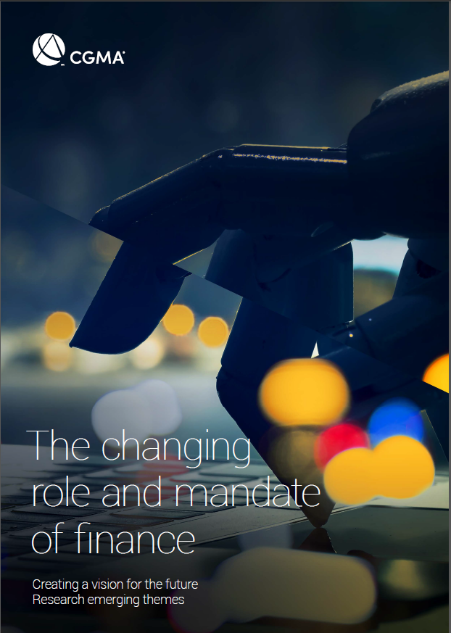


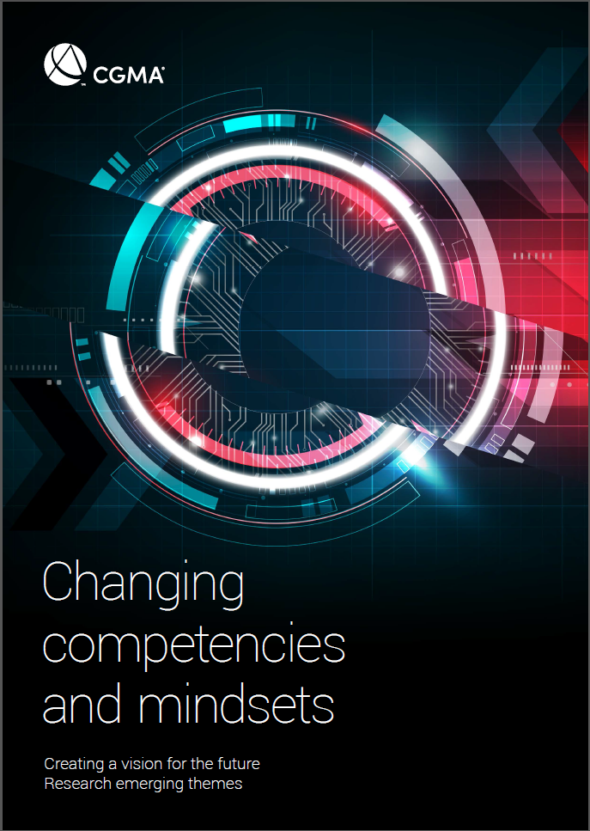
Creating a vision for the future

Slide 6

300 individuals representing 130 organisations
Interviews
Roundtables
Online Survey
Notes:
Online global survey - closed April 2018
Overall response rate - 4692 (4,524 CIMA members and students, 168 external)

Slide 7
Theme 1:
The changing role & mandate of finance
“Finance is playing a strategic role for an organisation in transition.”
Notes:
According to a senior executive with a South African Telecoms company, ‘Finance is playing a strategic role for an organisation in transition’.
This mandate is based on a belief, that the function has a unique end to end view of an organisation, and that the Chief Financial Officer (CFO) has the business understanding to work alongside the Chief Executive Officer (CEO) as a co-pilot.

Slide 8
Basic Finance Activities and Risk of Automation
Change Management
Negotiation
Communication
Influencing
Assemble
Business skills
Analytics
Advise
Information
Insight
Influence
Impact
Problem-solving skills
Technical skills
Analyse
Apply
Finance works with others
Finance works in isolation

Slide 9
Theme 2
Changing technology and finance
“The things we talk about when we set our strategic objectives for the year are money and how we keep pace with technology.”
Notes:
This is the stark reality for one US retailer – and it’s a common theme that’s shared by many other interviewees. It’s true that advancements in technology are allowing us to do much more than any of us have been able to do in the past. However too many organisations are struggling with the pace of change, constantly having to react rather than lead with technological innovation.
In our interviews, technology is seen as the key driver of change in the finance function. This ‘disrupter’ presents both an opportunity and a risk. It is transforming what we as finance professionals do and revolutionising how the finance function of the future will be deployed.

Slide 10
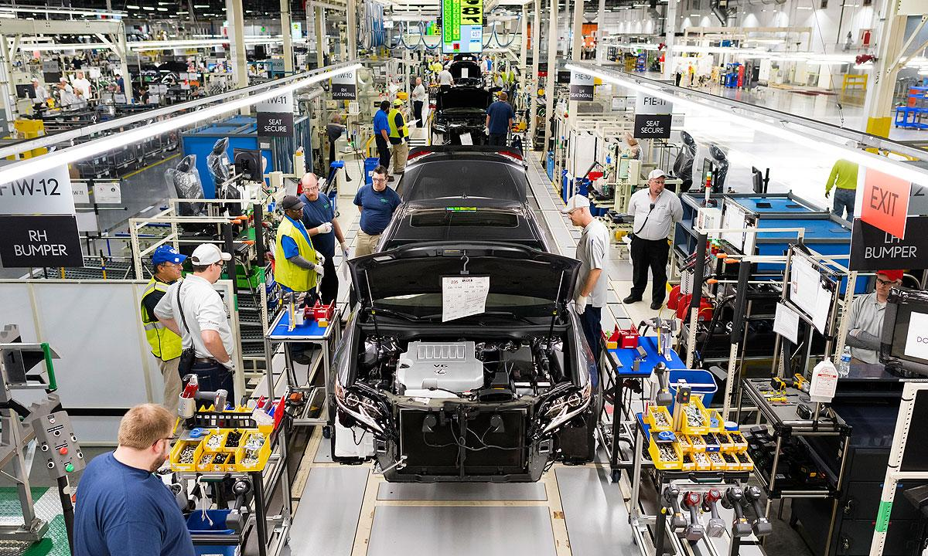
Before Automation

Slide 11
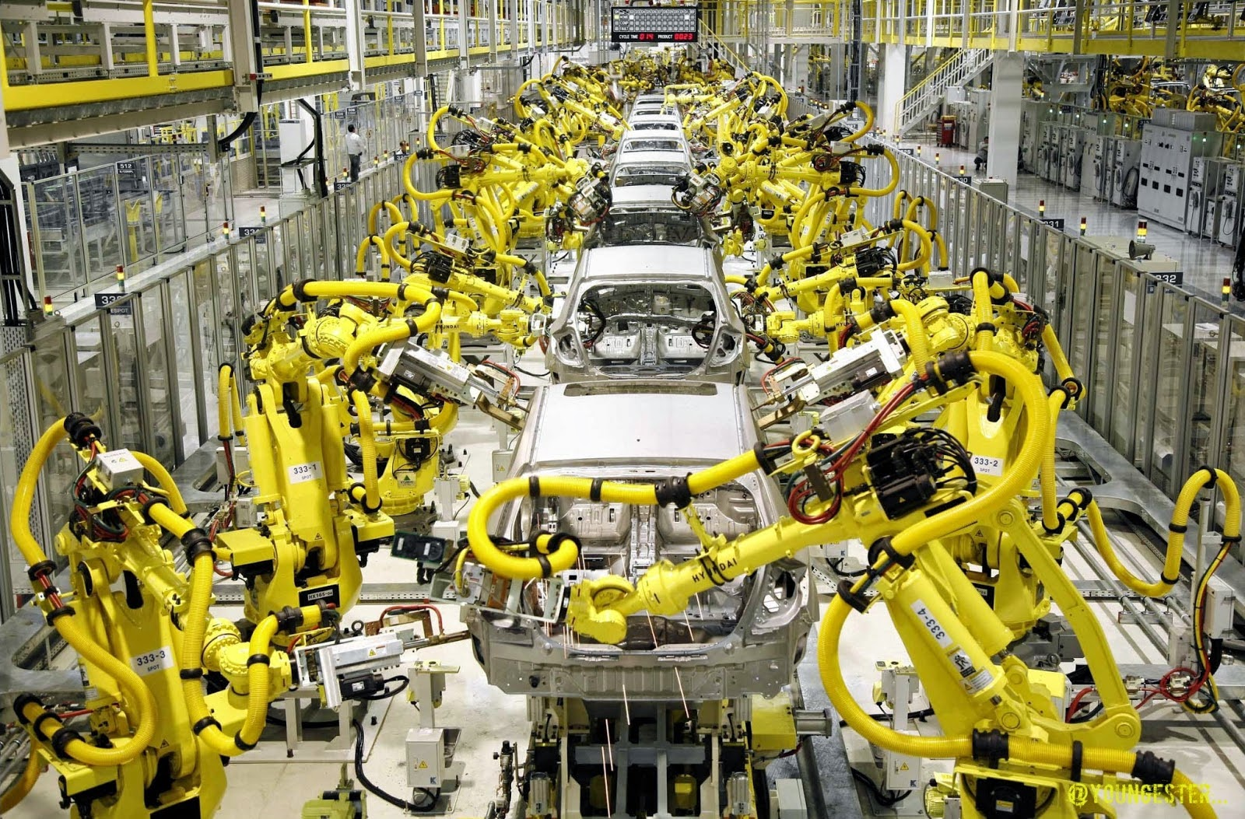
After Automation

Slide 12

Before Automation

Slide 13
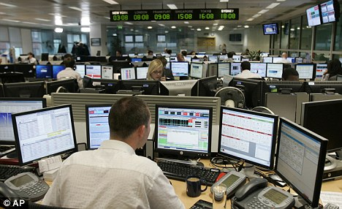
After Automation

Slide 14
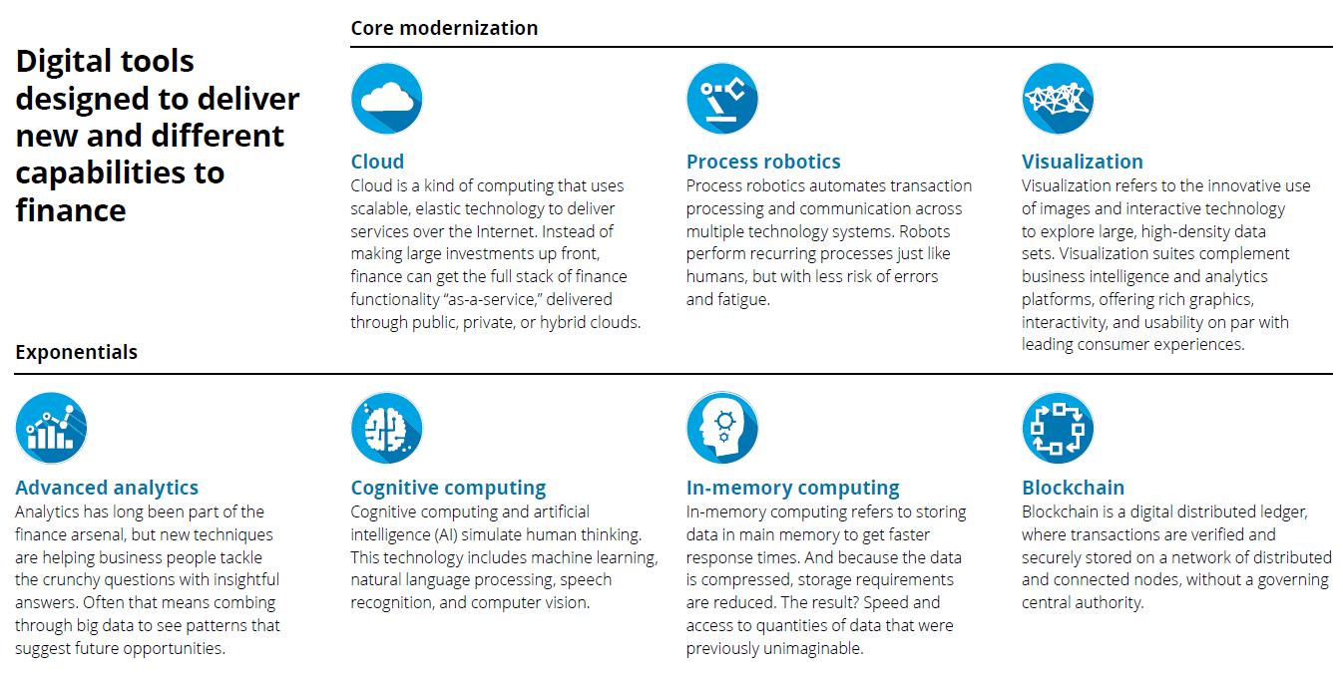
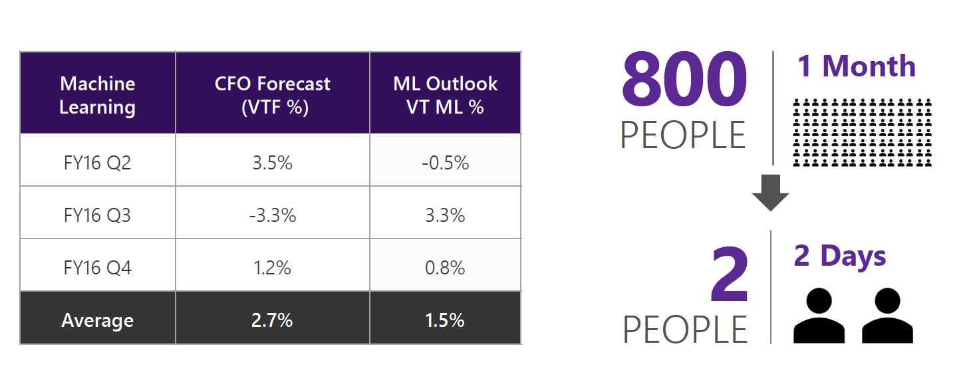
Technology
Emerging
Notes:
A 2016 Deloitte report into Finance in the digital world, based on interview research, focused on technology disruption that finance functions were experiencing. The report listed seven technologies that modern finance functions must have on their radar. The here now tools are ones specifically focus on updating financial systems and existing capability, whereas emerging tools concentrate on delivering new capabilities to the finance function..

Slide 15




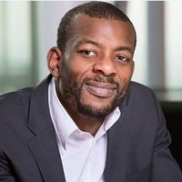
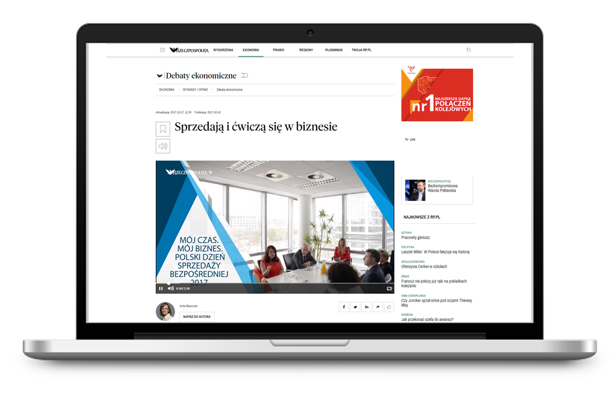
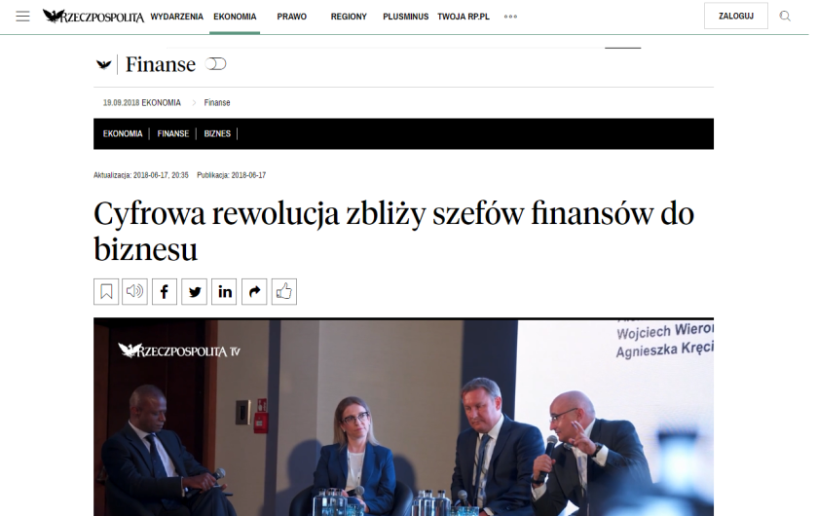
11th April 2019, WARSAW
PAUL BENJAMIN
CFO, Microsoft Europe

Slide 16
Theme 3
The changing shape of the finance function
“The expectations of the finance role have changed. Finance is now embedding itself across the business.”
Notes:
When an interviewee from the Indian banking sector shared this insight, it further emphasised the pattern of responses demonstrating the radically changing shape of the finance function.

Slide 17
Evolving shape of finance
Hierarchical
Segregated
Digital age

Slide 18
Evolving shape of finance
Senior Finance Team
Leading the finance team
Impact
Strategic Business Partnering
Partnering for value to influence and shape how the organisation creates and preserves value
Influence
Digital Centres of Excellence
Specialists generating further insights in their areas of specialism
Insight
Smart Finance “Factories”
Assembling and extracting data and providing limited insight
Information

Slide 19
Theme 4
Changing competencies & mindsets
“Finance people need a mindset that enables them to adapt through continuous learning.”
Notes:
Until recently, we have assumed that competencies influence and enable performance. However, throughout the face-to-face phase of this project, many interviewees made reference to ‘the mindset of the management accountant’, presenting personal views of what makes a good finance professional. In one interview, a banking sector representative explained that the organisation looked for “broad capability and a mindset rather than the ability to use certain tools and techniques” when hiring finance professionals.

Slide 20
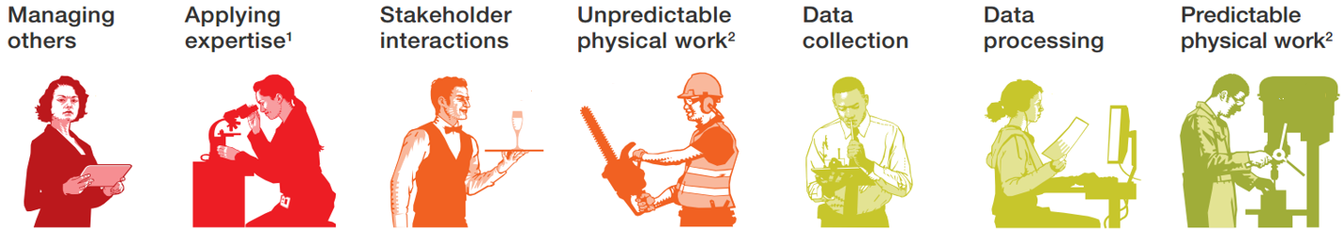
Implications of technology on future of finance
78%
69%
64%
25%
20%
18%
9%
MORE AUTOMATABLE ACTIVITIES
LESS AUTOMATABLE ACTIVITIES
Source: McKinsey, Where machines could replace humans – and where they can’t (yet)
Notes:
For the finance professional, the automation of repetitive tasks, will free up their time to concentrate on creating and preserving business value. This shift in skills sets from ‘knowledge’ to ‘meaning’ is self-evident in a 2017 McKinsey report into automation. McKinsey’s research examines groups of occupational activities, and ranks them according to which are highly and least susceptible to automation. Work activities at risk of automation include; data collection, data processing, and, predictable physical work. Less automatable activities include; managing others, applying expertise, stakeholder interactions, and, unpredictable physical work. Their prediction is that; ‘while few occupations are fully automatable, 60 percent of all occupations have at least 30 percent technically automatable activities’.

Slide 21
Competencies of the future

Slide 22
CGMA Competency Framework: Addressing the Gap
CGMA Competency Framework – CIMA/AICPA 2014

Slide 23
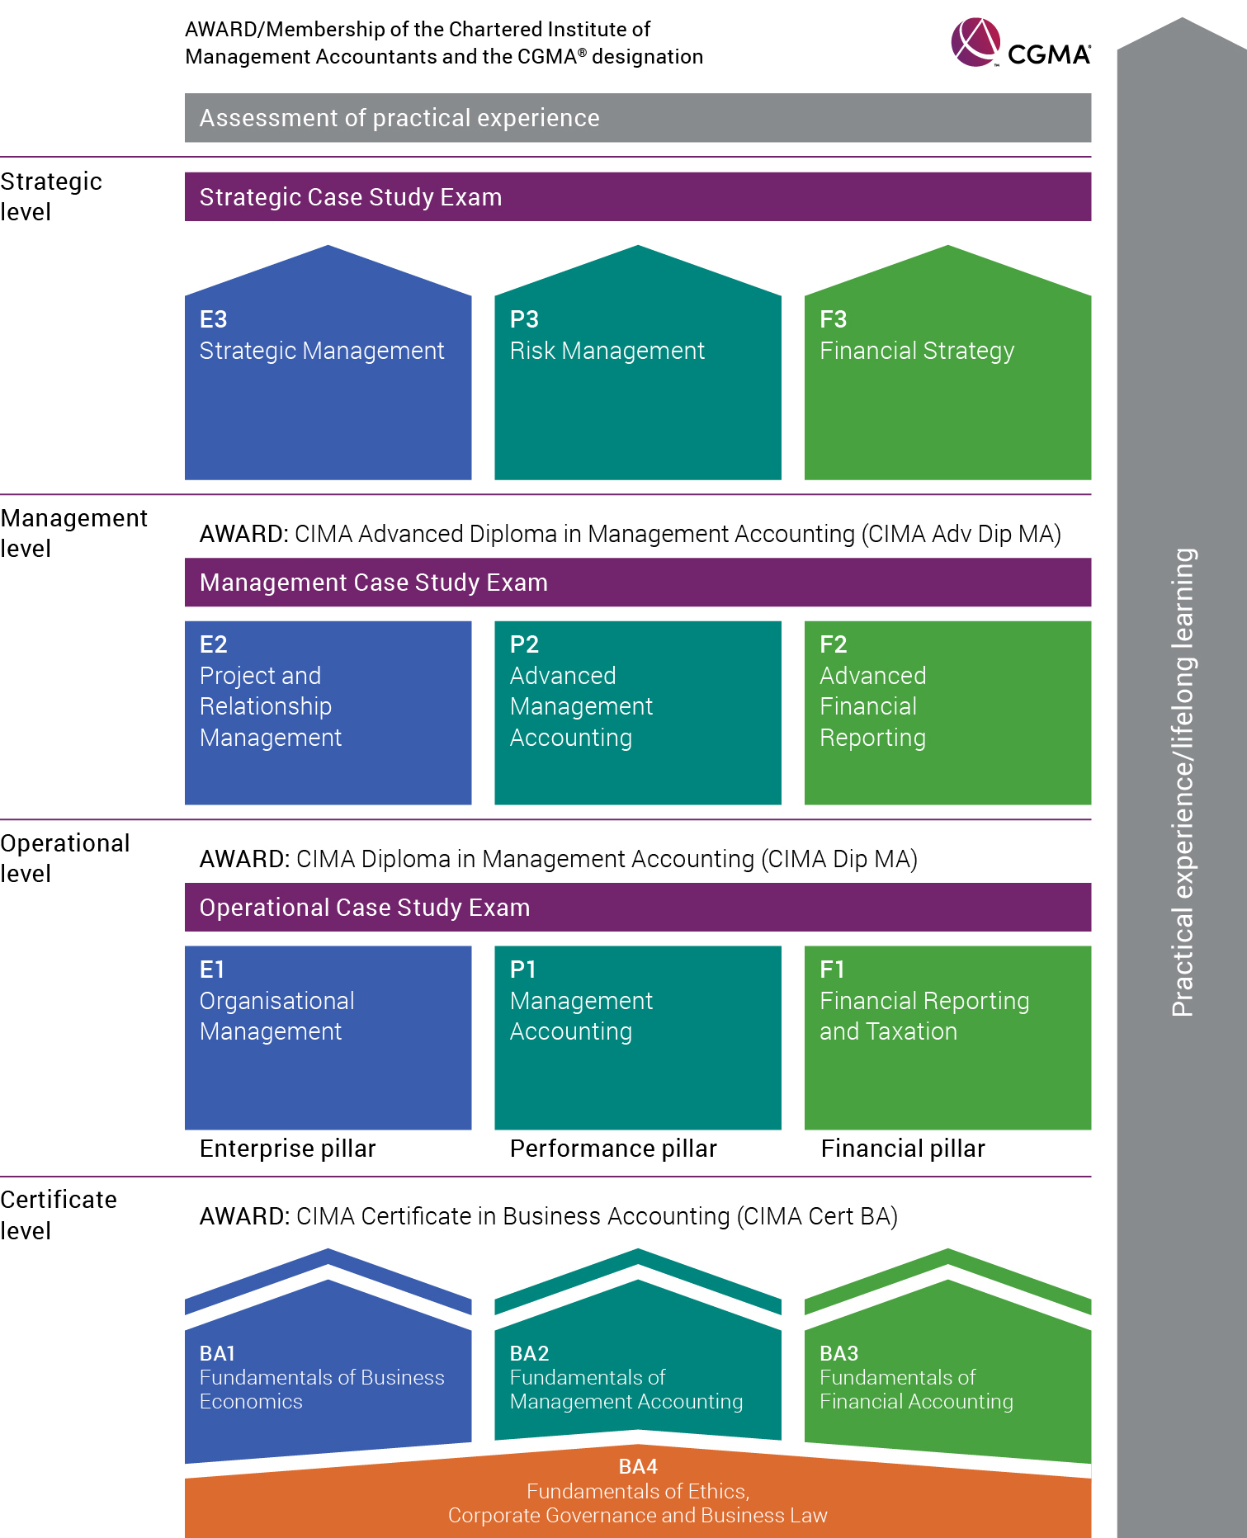
CGMA Syllabus
Enterprise pillar
How do we develop strategy and plan for its effective implementation?
The Pillars
Performance pillar
How do we ensure that our strategy is realistic and that we are implementing it effectively?
Financial pillar
How do we prepare and interpret financial statements to show how well we are doing and to help us make decisions?
Notes:
9x Objective tests -> 100% of syllabus components tested >Computer marked > Available year-round
3x Integrated case study exams > Long and short answer essay questions > Human marked > 4 exam sittings per year

Slide 24
Thank You
Piotr Głowacki
Senior Manager, Business Development CIMA
piotr.glowacki@aicpa-cima.com

