Slide 1
Best University-Business Cooperation of the Year
March 6th, 2024

Slide 2
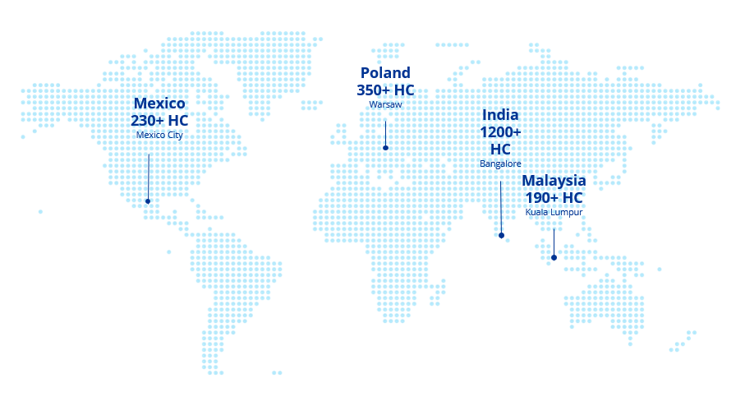
What is Alcon?
Presenters
Alcon is the global leader in eye care, dedicated to helping people see brilliantly. With an over 75-year heritage, we are the largest eye care device company in the world, with complementary businesses in Surgical and Vision Care.
Alcon offers the widest array of surgical equipment, ocular health products and contact lenses in the industry. We touch millions of lives in over 140 countries. Our Surgical products rank number one in market position globally. Our Vision Care products are among the world’s most trusted.
Rafał Jatczak
Talent Acquisition Manager
Alcon Global Services
AGS Poland in numbers
350
11
employees
functions
Kamil Merks
Director, On-Prem Services ADH Community Lead
38
20%
nationalities
gen-Z

Slide 3
OptiVisionary Early Careers Program (founded in 2022)

Slide 4
Our needs and objectives
Identify and recruit top-tier students with niche capabilities
Help to shape curricula to align with industry needs
Tailor Early Careers Program
Employer Value Proposition and Employer Branding Visibility amongs Gen-Z

Slide 5
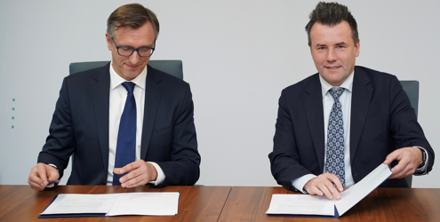
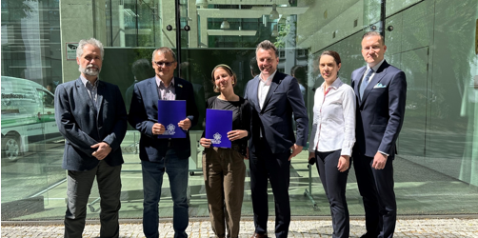
Our solution – Early Careers Program Partnerships
Talent Pipeline and Skill Development
Innovation and Research Collaboration
University of Warsaw
Warsaw University of Technology

Slide 6
Our solution – Early Careers Program Activities
Foster Your Brilliance with Alcon on the UW Campus
1
1
IT Job Fairs
Alcon Open Day on UW
2
2
Lectures for WUT MINI Students
Alcon zone on UW Campus
3
Alcon Digital Hub
3
Research and Knowledge sharing
Alcon Digital Hub
HR&FRA Early Careers Mentorship
4
4
ADH Site Visits
Free eye examination and Alcon products for students
5
5
ADH Digital Labs
Free eye examination for the academics
6
6
Participation in the University of Technology Program Council

Slide 7
Our solution – Early Careers Program AGS Poland Agility
STRATEGIC
TIME
OPERATIONAL AND TRANSACTIONAL
BRAND ADHERENCE
COST
Notes:
1. strategiczna (WAW AGS leadership)
2. czasowa (działania i efekty realizowane i mierzone kwartałami)
3. kosztowa (grant na współpracę z uczelniami, RPO, salary cost saving)
4. wizerunkowa (talent attraction strategy skierowana do GenZ (działania na uczelni, targi pracy)
5. operacyjna/tranzycje (efektywne szybkie wsparcie pracowników poprzez stazystów zaaopiekowanych przez 10 m-cy przeciętnie 40 tygodni lub 280 dni oraz FRA, IT tranzycje do Polski)

Slide 8
Our solution – Early Careers Program 2023 Accomplishments
90% of our Trainees have been offered jobs at Alcon
Launch of Foster Your Brilliance with Alcon on UW Campus, Assessment Center and workshops
Sustained Operations Efficiency Trainees in major transition programs with Buddy support and supervision
Elective course for students at WUT: Mathematical Optimization Algorithms + Labs for IT Students in the Warsaw office
Digital Competency Center (Alcon Digital Hub), knowledge and best practices transfer across three Alcon Global Services Centers
Notes:
*Others include DHS, HR OPS, IP, CMT + TCI + PIM + MTO + Digital + Other functions Organic Growth etc.

Slide 9
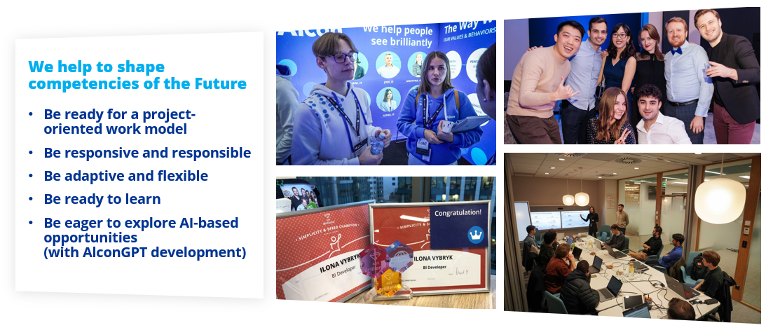
And our Trainees’ success stories Ilona, Aghayev, Mert, Celen, Kim, Cheng

