Slide 1
The Future of Finance
Overcoming the Unprecedented skill gap
Ash Noah, CPA, CGMA, FCMA
Managing Director, CGMA Learning, Education & Development AICPA-CIMA
Association of International Certified Professional Accountants

Slide 2
Knowledge doubles every 11 hours
Buckminster Fuller's Knowledge Doubling Curve, with post-1982 addition by IBM
Notes:
Modern estimates place the half-life of an engineering degree at between 2.5 and 5 years, requiring between 10 and 20 hours of study per week.”

Slide 3
The role of the Finance Function
Human Skills
Tech & Automation
Assembler
Advisor
Architect
Information
Insight
Influence
Impact
Insight
Influence
Impact
Analyser
Actuator
Business Guidance
Governance

Slide 4
The role of the Finance Function
Human Skills
Tech & Automation
Assembler
Advisor
Architect
Information
Insight
Influence
Impact
Insight
Influence
Impact
Analyser
Actuator
Value mind-set
Cost mind-set

Slide 5


Slide 6
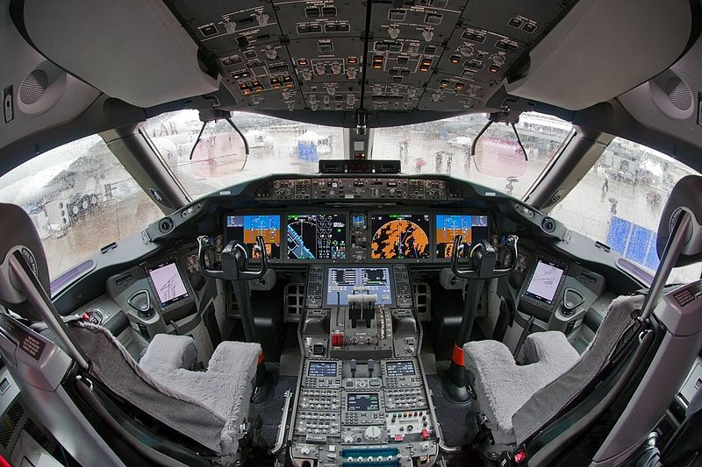

Slide 7
The role of the Finance Function
Human Skills
Tech & Automation
Collate
Communicate
Create
Information
Insight
Influence
Impact
Insight
Influence
Impact
Curate
Collaborate
Co-pilot
Navigator

Slide 8
Competency
Tech & Automation
Assembler
Advisor
Architect
Information
Insight
Influence
Impact
Insight
Influence
Impact
Analyser
Actuator
Co-pilot
Navigator

Slide 9
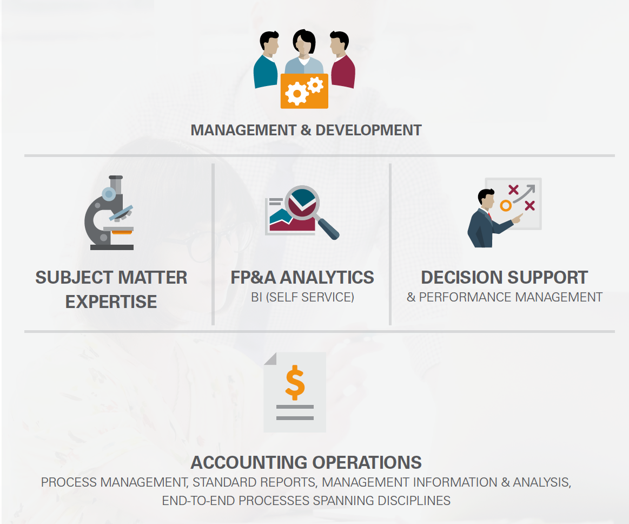
The new operating model for modern finance

Slide 10
The new shape of modern finance

Slide 11
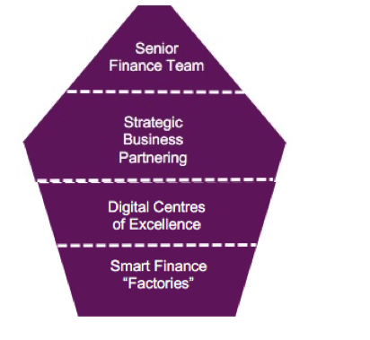
Evolving shape of finance

Slide 12
Human Skills
Tech & Automation
Assembler
Advisor
Architect
Information
Insight
Influence
Impact
Insight
Influence
Impact
Analyser
Actuator
Co-pilot
Navigator

Slide 13
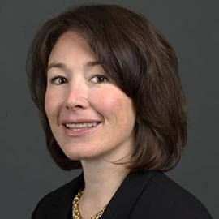
“
The hardest part of digitally transforming a company is not the technology - it’s the sociology
”
Safra Catz
CEO, Oracle

Slide 14
The rising need for Human Skills
TOP SKILLS IN 2020
Complex problem-solving
Critical thinking
Creativity
People management
Coordinating with others
Emotional intelligence
Judgement and Decision-making
Service orientation
Negotiation
Cognitive flexibility

Slide 15



Inversion of required Skillset
Before
Skillset
After
Deep analytical and strategic thinking
Influencing and negotiating
Diverse project management
Advanced business knowledge
Operational thinking
Transactional expertise
Task management
Basic business understanding

Slide 16
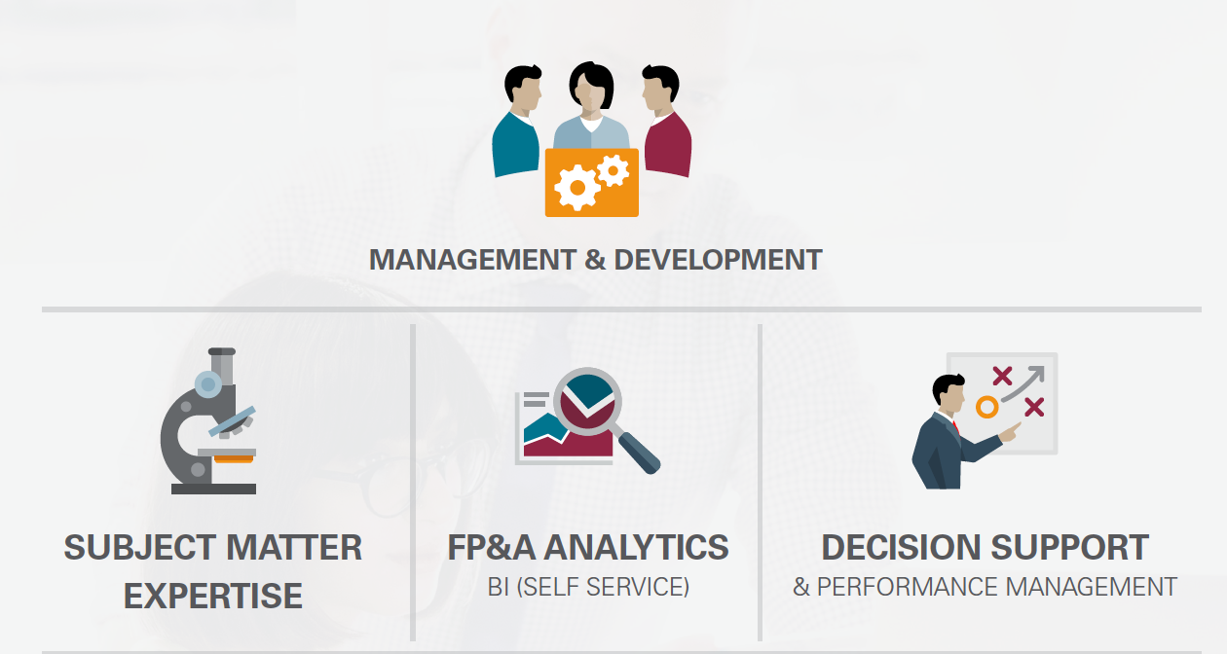
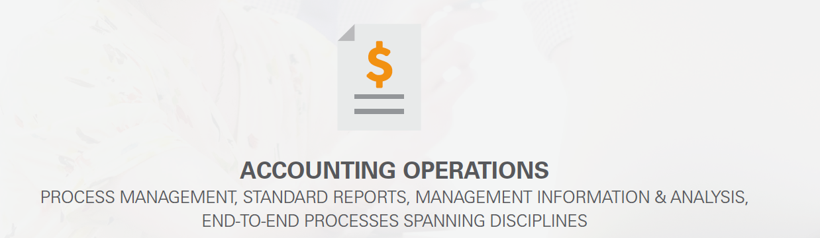
Implications of the operating model for modern finance

Slide 17
Emerging opportunities and implications
GLOBAL CFO SERVICES
BUSINESS FUNCTIONS

Slide 18
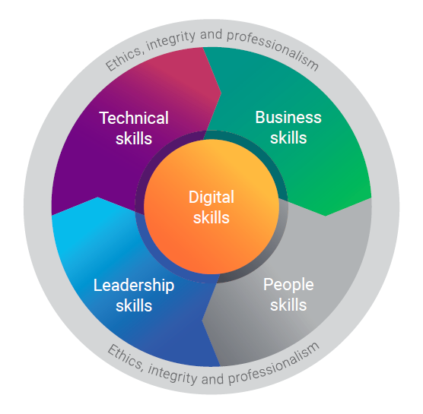
CGMA Competency Framework

Slide 19
Key Areas of Focus in the CIMA Syllabus
STRATEGIC
LEVEL
Strategic Management
Strategy Development and Implementation, Change Management, Digital strategy and Transformation
Risk Management
ERM, Internal Control, Corporate Governance, Financial Risk Management, Cyber Security
Financial Strategy
Financial Objectives, Corporate Financing
Regulatory compliance, Mergers & Acquisitions
MANAGEMENT LEVEL
Project and Relationship
Project Management,
Communication, Managing Relationships, Business Models
Advanced Management Accounting
Cost Management, Organizational Performance, Investment Decisions
Advanced Financial Reporting
Group Accounting, Disclosures, Financial Statement Analysis
OPERATIONAL
LEVEL
Digital Finance
Finance function transformation, Finance Technologies, Data Analytics
Management Accounting
Cost Accounting, Budgeting, Short Term Decision making
Financial Reporting and Taxation
Regulatory Frameworks, Financial Accounting and Reporting, Fundamentals of Taxation
ENTERPRISE
PERFORMANCE
FINANCIAL
Notes:
DANIEL

Slide 20
CGMA Competencies
Tech & Automation
Assembler
Advisor
Architect
Information
Insight
Influence
Impact
Insight
Influence
Impact
Analyser
Actuator
Co-pilot
Navigator
Co-pilot
Navigator

Slide 21
Thank You ash.noah@aicpa-cima.com

