Slide 1
Global Business Services –
Overview 2020 and Outlook
Tom Bangemann, SVP Business Transformation, The Hackett Group
January 2020

Slide 2
From Shareholder Value to Stakeholder Commitment
Recent thinking questions 30+ year mantra on shareholder value focus only

Slide 3
Company Mission
The most prevalent company mission is serving broad stakeholder interests, closely followed by long-term strategy execution
Company mission
(percentage of companies selecting option best describing its mission)
* Shareholders, customers, suppliers, employees, communities, environment
Source: Key Issues Study, The Hackett Group, 2020

Slide 4
Ranking of major initiatives on enterprise calendar
Cost returns to top of enterprise agenda; technology issues have new prominence and shape business services functions agenda
Percentage of companies with major initiatives on 2020 agenda
Market
Operations
Digital
People
* Product innovation, product development, acquisition of new product or service lines ** E.g., entering new geographies, segments, development of new channels
*** Fundamental transformation of the way your organization operates, innovates, goes to market, engages with stakeholders and/or executes work, using digital technologies
**** Initiatives aimed at improving the company's social accountability. Includes environmental, philanthropic, responsible sourcing, community relations, business ethics and diversity/equality initiatives
Source: Key Issues Study, The Hackett Group, 2020

Slide 5
Projected revenue and functional budget YOY change, 2019-2020
Respondents are projecting a slowdown in revenue growth, a significant cutback in finance operating budget, and moderate increase in IT operating budget
2019
2020
Revenue Growth
G&A Operating budget
Finance Operating budget
HR Operating budget
IT Operating budget
Procurement Operating budget
Source: Key Issues Study, The Hackett Group, 2020

Slide 6
GBS staffing and operating budget change
Projected GBS staffing growth far exceeds revenue growth and operating budget growth, indicating expanding workloads moved into GBS, and expansion of low cost (offshore) labor use, driving down the blended wage rate
Revenue Growth
Number of staff (FTEs)
Operating Budget
Source: Key Issues Study, The Hackett Group, 2020

Slide 7
Current and projected business risk
Cybersecurity tops the list business risks and is expected to increase significantly at almost the same rate as disruptive innovation, which will see the largest increase
Current level of concerns about business risk and projected change
Net risk increase (respondents projecting increase minus projecting decrease)
Source: Key Issues Study, The Hackett Group, 2020

Slide 8
As GBS organizations mature, the need for talent that has GBS specific skills & capabilities is crucial to achieve World class performance levels
Service-oriented Integrated Business Services stand-alone entity
Commercial performance profile
Service catalog centric
Beginning-to-end service orientation
Revenue-enabling knowledge centers of excellence
Innovation contributors
Total business value focus
2017
Today
Stage
3
Integrated
services
operations
8%
9%
Multi-function Global Business Services org
End-to-end process orientation
Global Process Ownership
Integrated, infrastructure, or hybrid center model
Service management implementation
Enterprise standards driven
Performance technology improvement
Knowledge centers of excellence
BPO & managed services outsourcing
Service effectiveness focus
Stage
2
Maturity Stage
Multi-function integration
35%
44%
Stage
1
Functionally focused & owned platform
Transactional standardization
Regional Shared Services consolidation
Transactional automation
Cost reduction focus
Single function consolidation
57%
47%
Focus
Indicates % of Shared Services / GBS organizations at that Stage

Slide 9
Causing a paradigm shift in how we organize work
1
2
3
FUNCTIONAL ORIENTATION
PROCESS ORIENTATION
CUSTOMER ORIENTATION
ORGANIZING PRINCIPLE:
Task specialization based on physical proximity of people to recording, manipulate and output data to create products & services
ORGANIZING PRINCIPLE:
Data recording, manipulation and output generation from enterprise resource information technology systems to create products & services
ORGANIZING PRINCIPLE:
Capture data digitally at source and transform to create products & services maximizing use digital technology

Slide 10
Cost effectiveness and compliance focus remain core to GBS strategic goals; service excellence, agility and customer intimacy objectives are difficult to achieve
How effective is your GBS at achieving the following strategic objectives?
Importance
ranking
Percentage of organizations considered effective/highly effective
Compliance
Focus
with financial, operational rules and regulations
1
5
Cost Leadership Focus
Reduce GBS operating cost
3
Alignment
with corporate and business unit strategic goals
6
Service
Excellence
Focus
Deliver a high-quality services portfolio
2
4
Agility Focus
Contribute to enterprise agility
Customer
Intimacy Focus
Be valued as a business partner
Source: The Hackett Group’s annual Global Business Services (GBS) performance study, 2019
Notes:
Like their host enterprises, GBS can aspire to a variety of strategic objectives. The ability to achieve these goals is fairly consistent with one notable exception.
Service excellence, agility and customer intimacy objectives appear difficult to achieve. In particular customer intimacy effectiveness is lower than previous years, which may well be due to increasing customer expectations as much as GBS capability to deliver
Cost effectiveness and compliance focus, together with business alignment remain core GBS strategic goals and are typically areas in which GBS perform well.

Slide 11
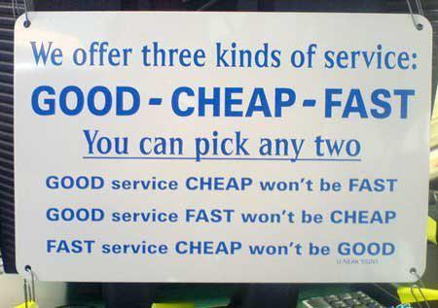
Can your GBS Customers pick all three...
... do they know, and acknowledge it?

Slide 12
Hackett Digital Transformation Landscape
INTENSIFYING COMPETITION
Global competition | Margin pressure | Merger and acquisition
DISRUPTIVE INNOVATION
Digital disruption | Product and service innovation | Business model innovation
BUSINESS EXPECTATIONS
Cost leadership | Delight customers | Perfect quality | Agile operations | Flawless compliance | Enable innovation leadership | Support decision-making excellence | Extend service – partner value
CUSTOMER-CENTRIC
Design thinking | Digital customer engagement | Customer journey mapping | Segmentation | Individualisation | Omnichannel
DIGITAL OPERATIONS
ERP modernisation | Cloud | Mobility | Internet of things | Social technologies | Blockchain | Process mining | Disruptive point solutions | RPA | Cognitive automation | Orchestration | Conversational interfaces | Smart data capture
DIGITAL INSIGHT
Predictive modelling | Analytics | Big data | Data visualisation | Data integration | Data mining
Smart automation

Slide 13
Digital Transformation Is About Combining New Tools, Techniques and Technologies

Slide 14
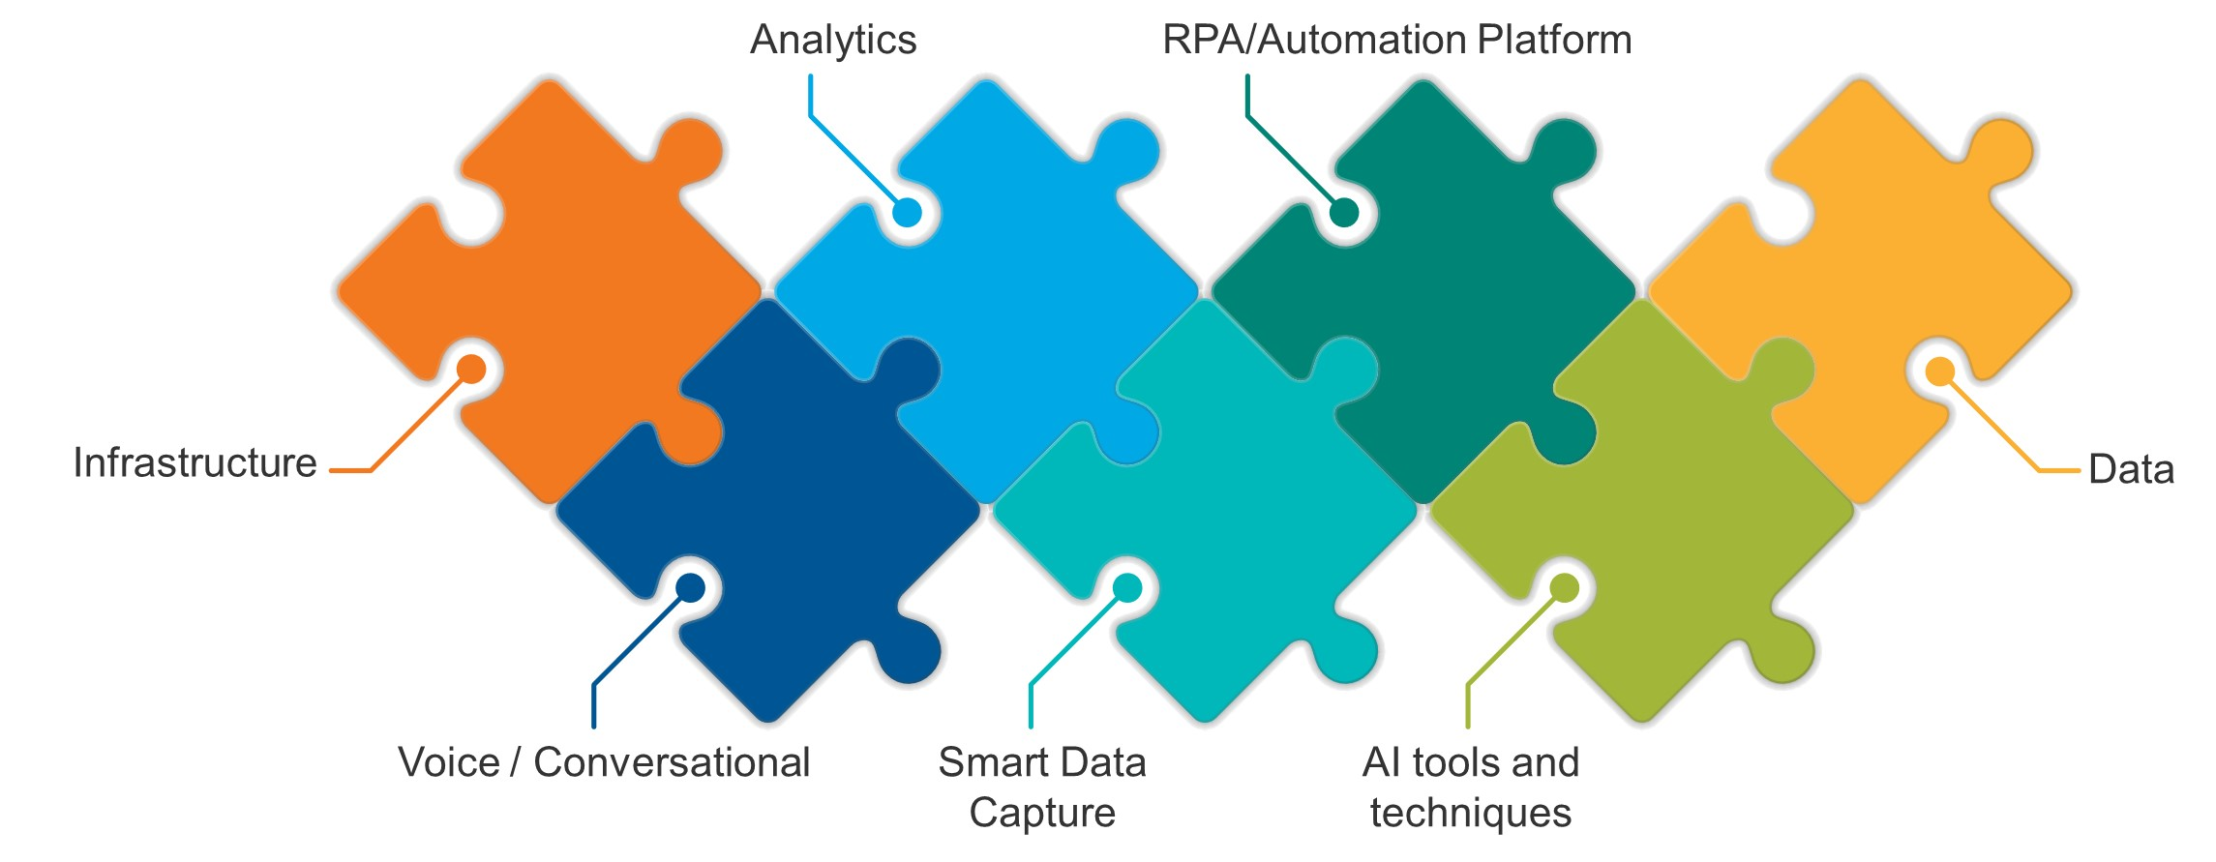
Talent management issue: skills needed for tech ecosystem
Analytics
RPA/Orchestration
Data
Smart Data Capture
Voice / Conversational
AI Tools and Techniques
Mobility / Infra.
Source: 2017 & 2018 Awards Submissions, The Hackett Group

Slide 15
Automation levels in GBS are often not known as they are not measured
% Managed by GBS maturity stage
Managed - KPIs defined, targets set; major initiatives defined
Targeted - KPIs defined, targets set; no major initiatives defined
Measured - KPIs defined, no targets set, no major initiatives defined
None - limited or no KPIs defined
Source: The Hackett Group’s Global Business Services (GBS) performance study, 2016

Slide 16
Technology adoption and effectiveness
Cloud computing is widely deployed and targeted for high growth while legacy adoption is in decline; best of breed meet expectations most
Current adoption
2020 growth projection¹
Business objectives² realization
Fell short of expectations
Exceeded expectations
Met expectations
* The technology is used on a limited scale in isolated use cases
** The technology is used at scale in applicable use cases
¹ Year-on-year percentage change in applicable adoption metric for each technology
² E.g., ROI, Payback, cycle time improvement, quality of service improvement, customer experience improvement
Source: 2019 Key Issues Study, The Hackett Group
Source: Key Issues Study, The Hackett Group, 2020

Slide 17
Data and emerging technology adoption, 2020 growth and objectives realization
Data related technologies are reaching broad-based adoption and continued fast growth. Emerging technologies growth is more modest. Realization of business objectives of advanced analytics and chatbots and AI has been below par
Current adoption
2020 growth projection¹
Business objectives² realization
Data
related
technologies
Emerging
technologies
Fell short of expectations
Exceeded expectations
Met expectations
* The technology is used on a limited scale in isolated use cases
** The technology is used at scale in applicable use cases
¹ Year-on-year percentage change in applicable adoption metric for each technology
² E.g., ROI, Payback, cycle time improvement, quality of service improvement, customer experience improvement
Source: Key Issues Study, The Hackett Group, 2020

Slide 18
For many companies, reality looks like this:
Actual RPA adoption in finance
Forecasted RPA adoption 2-3 years in finance
86%
Expectation Gap
66%
78%
66%
38%
38%
21%
21%
At this pace, my three-year transformation plan is going to take 10 years.

Slide 19
Unlocking Digital Value – The Race to Transform First
?
“When digital transformation is done right, it’s like a caterpillar turning into a butterfly, but when done wrong, all you have is a really fast caterpillar.”
George Westerman, Principal Research Scientist with the MIT Sloan Initiative on the Digital Economy

Slide 20
Client Example: A metamorphosis needed
A caterpillar forms a cocoon, digests its own tissues, and certain highly organised cells survive the digestive process, and start to become the butterfly’s eyes, wings, etc.

Slide 21
10 Characteristics of World-class GBS Organizations
10. TALENT MANAGEMENT Emphasize talent retention and cross-functional development for valued employees, stimulate business partnering
1. STRATEGIC ALIGNMENT Focus on business and GBS strategy alignment and deliberately communicating value delivered
9. ANALYTICAL CAPABILTIES Create value beyond labor arbitrage through analytics and other non-transactional services
10
1
2. ORGANIZATION DESIGN Push boundaries of GBS model and placement between GBS, corporate center and business organization
9
2
8. DIGITAL TECHNOLOGY Lead on implementation of existing and emerging technologies to create a digitized service portfolio
WHAT WORLD-CLASS GBS DO BETTER
3. LEVERAGE Balance in-house versus third party capability for labor arbitrage maximization and productivity gain
8
3
7. SERVICE MANAGEMENT Master all elements of service management for an uninterrupted, seamlessly delivered service
7
4
4. GOVERNANCE Set clear accountabilities that drive effective decision-making and business partnership
6
5
6. CUSTOMER-CENTRIC Apply design thinking to create a customer-focused service experience
5. END-TO-END PROCESS DESIGN Organize with process (output) value in mind, transcending organizational boundaries
Source: The Hackett Group
GBS Executive Advisory Program| 21
Notes:
Over the course of many years and many studies, HCKT have established that there are 10 characteristics of a world class GBS org
New ones emerge as the world changes and the role that a GBS plays evolves, such as the drive for an increase in analytical capabilities.
However, the key elements remain the same, and the standout characteristic is Talent Mgt.
We see that the best performing GBS org, have a real focus and emphasis on having a world class talent management strategy, particularly around retention, cross functional devt and the fostering business partnering and relationships.
They also focus on attracting the best talent through a powerful employer brand and evp

Slide 22
GBS top 5 priorities for 2020
Consistent with the broader enterprise cost focus, improvement of GBS cost efficiency is the #1 ranked GBS priority for 2020
1
IMPROVE COST EFFICIENCY
Despite increased emphasis on value, improving cost efficiency is the number one issue for GBS organizations in 2020, ranked a high priority by 75% of them.
2
SECURE DATA AND SYSTEMS
Cybersecurity is ranked the #1 enterprise business risk, which is reflected in the priorities of business services functions and GBS organizations.
3
ALIGN SKILLS AND TALENT WITH BUSINESS NEEDS
As business needs and service portfolios evolve, GBS must align their talent with changes in demand. This requires strategic workforce planning, new talent acquisition and talent development.
4
IMPROVE AGILITY
Improving agility has become an imperative for companies to thrive in the digital era. To support this GBS organizations need to both support enterprise agility and become more agile themselves.
5
MODERNIZE APPLICATION PLATFORMS
Modernizing technology provides several benefits to GBS organizations, including improved agility, customer-centric processes and cost efficiencies.

Slide 23
2020 GBS agenda heat map: Objective priority vs. capability level
GBS must focus on improving support of cost, agility and analytics related enterprise objectives, while upgrading talent, modernizing application platforms and improving its own agility
Well supported
Improvement opportunity
Critical development area
Support enterprise growth strategies
Enable enterprise digital transformation
Enable enterprise agility
Enable enterprise analytics capability
Enterprise
objectives
Support enterprise cost efficiency improvement
Act as a strategic advisor to the business
Secure data and systems
Improve analytical capability
Improve performance measurement capability
Align skills and talent with business needs
Improve GBS agility
GBS
objectives
Improve GBS cost efficiency
Modernize application platform(s)
Heat map colors are determined by relative size of gap between each objective’s priority level (importance ranking) and GBS’s current capability to support or achieve the objective. The smallest gaps are green, largest are red.
Source: Key Issues Study, The Hackett Group, 2020

Slide 24
GBS transformation activity focus
Cost efficiency improvement is the most prevalent GBS transformation focus area, followed by application modernization
Percentage of GBS organizations with major improvement program planned or ongoing
C
C
C
C
Critical development area
Source: Key Issues Study, The Hackett Group, 2020

Slide 25
Questions?

