Slide 1
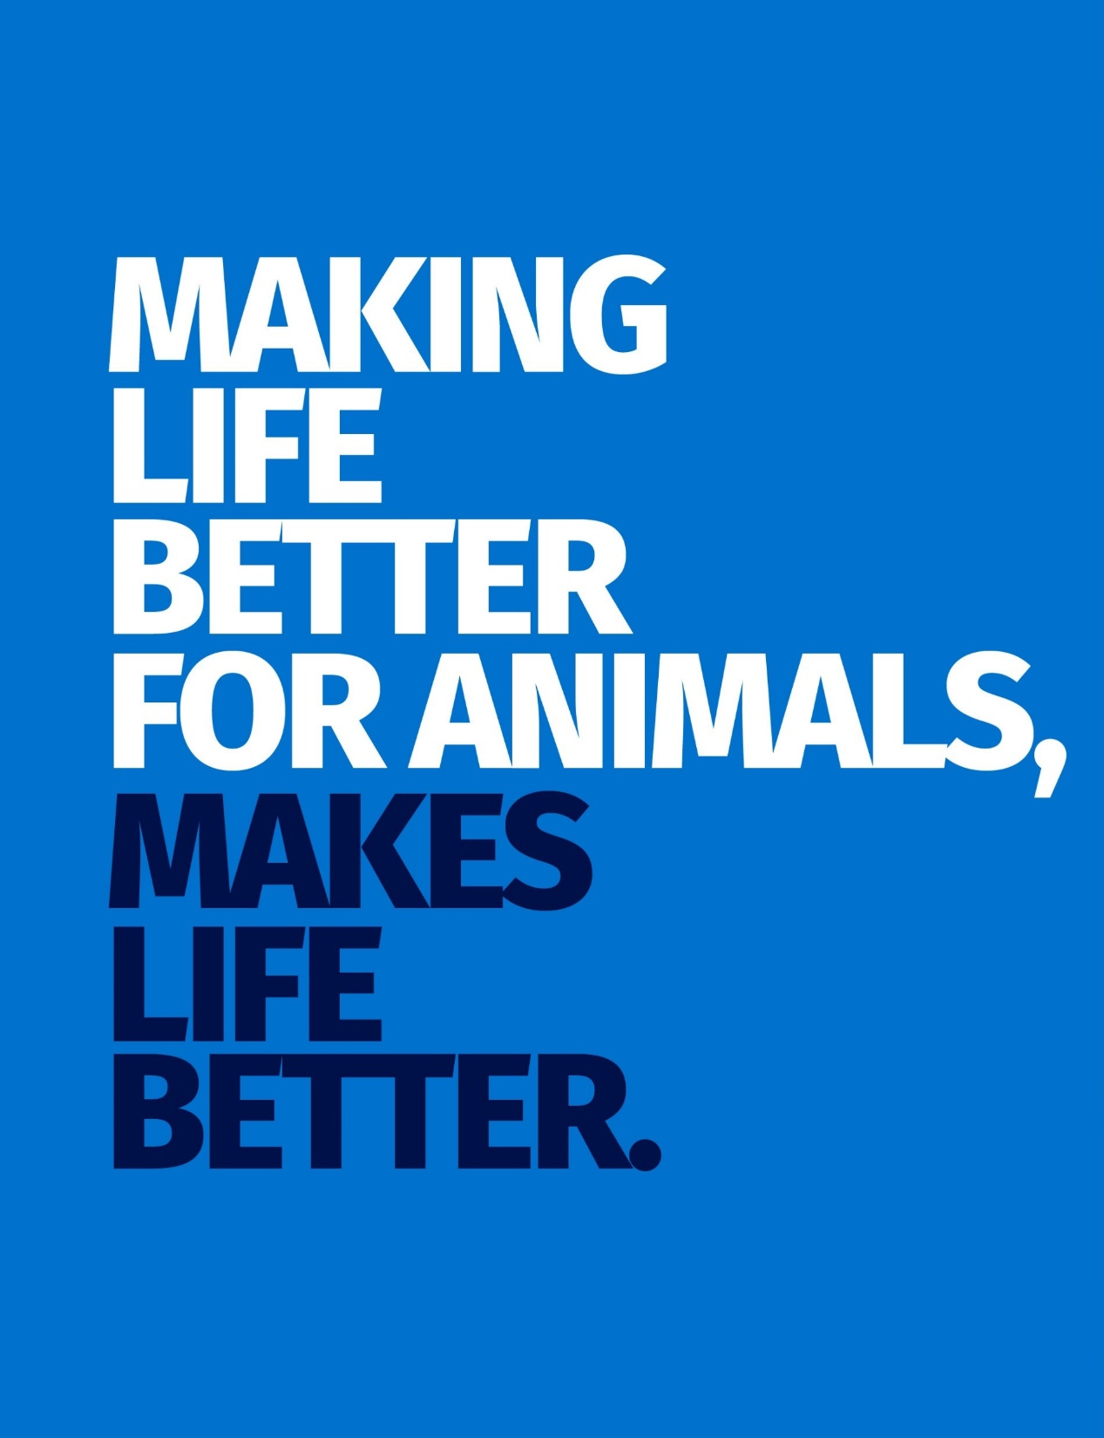
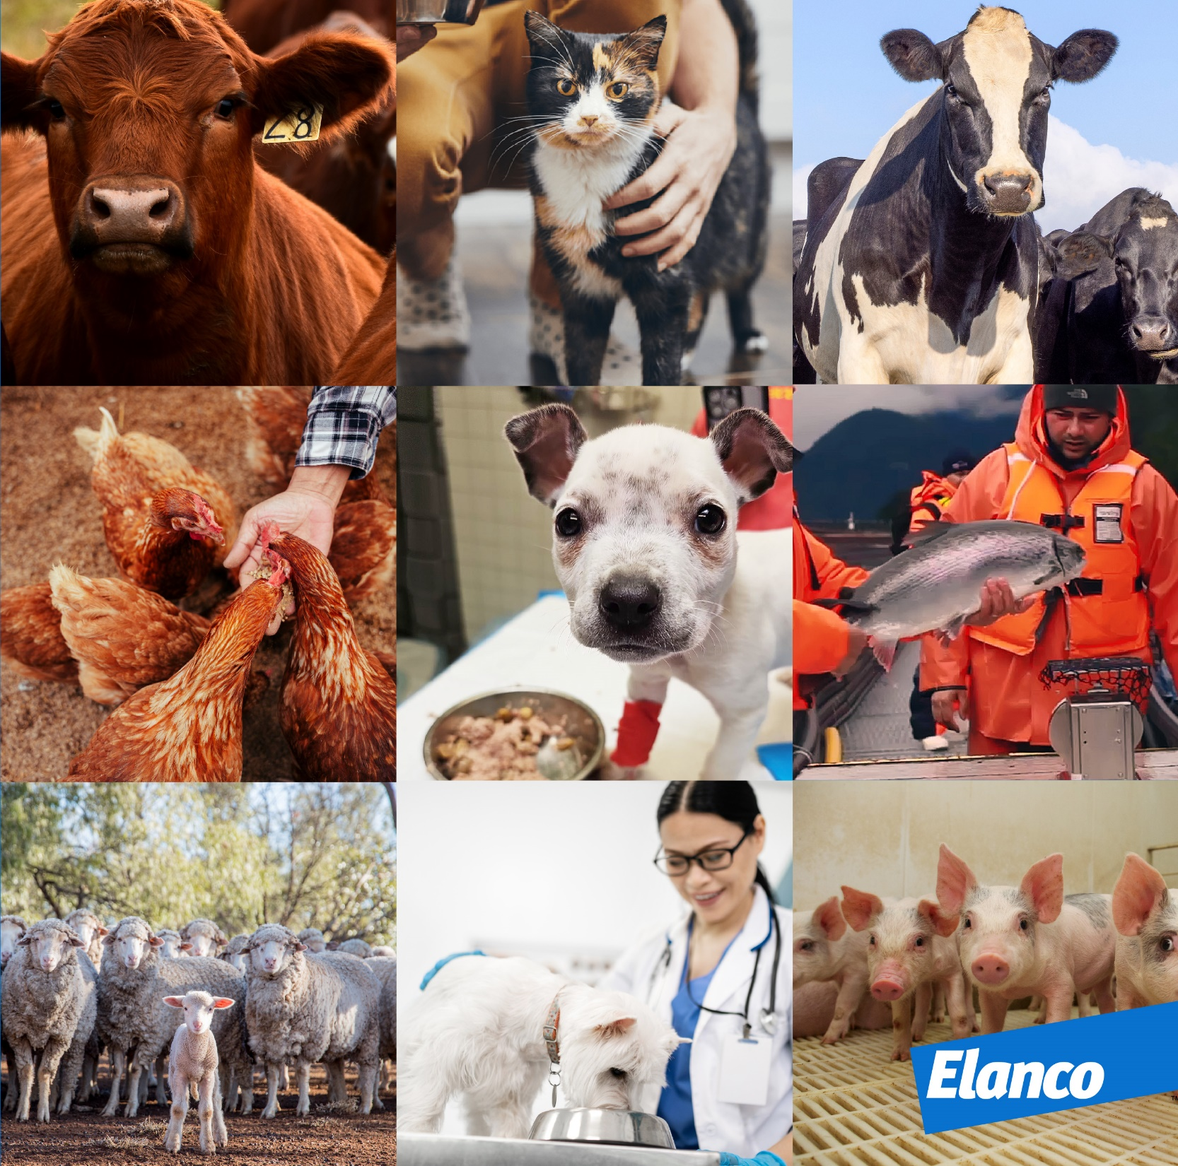
Notes:
Always remember WHY we do what we do – it’s to make life better for animals, which makes life better!

Slide 2
Leadership Attrition
ELANCO SOLUTION CENTER

Slide 3
VIDEO
File workplace final . MOV

Slide 4
7 Cutting Edge 2024 Market Trends on Employee Engagement
#1 Guided Growth: Set up Mentorship Programs
#2 Inclusive Decision-Making: Involve Employees in Company Decisions
#3 Promote Internal Mobility: Encourage Employee Growth Within
#4 Cultural DNA: Make Employee Recognition Plan
#5 Impactful Onboarding: Create an Onboarding Experience that Resonates
#6 Holistic Wellbeing: Prioritize Total Wellbeing
#7 Transparent Culture: Promote Transparency Across the Organization

Slide 5
VIDEO
File : final erg & csr MOV

Slide 6
ENGAGEMENT STRATEGY BASED ON EMERGENT PHENOMENA
10 Employee Resource Groups
Aligning strategically with DEI and business objectives
30% of employees belong to ERG groups
A wide demographic of members across all functions
Equal access to funds and leadership support

Slide 7
THANK YOU

